Slide 1
Parallel and Distributed Computation Introduction
Kun Suo
Computer Science, Kennesaw State University
https://kevinsuo.github.io/

Slide 2
Outline
Why study parallel and distributed computation?
What to learn?
Course structure
Course policy
An example of parallel and distributed computation

Slide 3
Self Introduction
Kun Suo, Ph.D. (UTA)
Homepage, https://kevinsuo.github.io/
Research interests:
Cloud computing and virtualization;
Parallel and Distributed Computation, containers and kubernetes;
Software defined network (SDN) and network function virtualization (NFV)
Big data systems and machine learning systems
Projects you may be interested in:
Several projects in Cloud & Data & Edge
https://kevinsuo.github.io/code-lab.html

Slide 4
Now it’s your turn
Name, program/year, where from
Your interests in Computer Science
Have you ever used or heard of parallel and distributed system? Can you name some of them? What do you expect from this course?
https://www2.eecs.berkeley.edu/Research/Areas/CS/
If you are in the online course, introduce yourself in D2L, Discussions → Self-Introduction

Slide 5
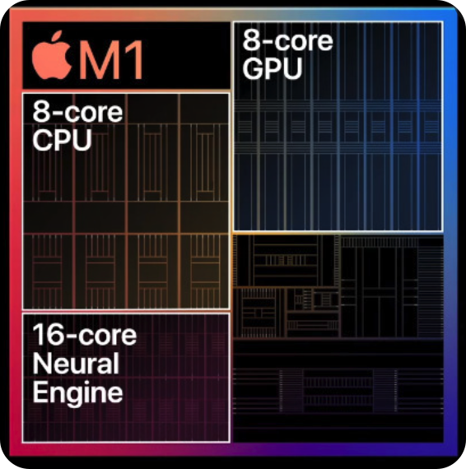
Example of parallel and distributed system
personal computer
internet
cloud
Social system
Notes:
Parallel systems are the systems that can process the data simultaneously, and increase the computational speed of a computer system.
Distributed system is a model where distributed applications are running on multiple computers linked by a communications network.
Front end: multiple users and apps
Backend: multicores, multi machines

Slide 6
Course Information
Instructor: Dr. Kun Suo
Office: J-318
Email: ksuo@kennesaw.edu
Only reply to e-mails that are sent from KSU student email accounts and title the course number [CS4504]
Office Hours:
Email or Microsoft Teams
By appointment
Course Materials
Homework assignments, lecture slides, and other materials will be posted in the webpage (https://kevinsuo.github.io/teaching/2022Fall/4504/class.html) and D2L.

Slide 7
Reference Book
“Distributed Systems 3rd edition (2017)” by M. van Steen and A.S. Tanenbaum:
ISBN-13: 978-1543057386
You can get a digital copy of this book for free: https://www.distributed-systems.net/index.php/books/ds3/

Slide 8
Reference Book
“An Introduction to Parallel Programming (2011)” by Peter S. Pacheco:
ISBN-13: 978-0-12-374260-5
You can get a digital copy of this book for free: http://www.e-tahtam.com/~turgaybilgin/2013-2014-guz/ParalelProgramlama/ParallelProg.pdf

Slide 9
Prerequisites
Computer basics that are supposed to covered in (CS 3502) Operating Systems and (CS 3503) Computer Organization and Architecture course.
C programming (code reading, kernel development and debugging). (Famous projects in C)
Linux command line environment (compiling, Makefile, debugging, simple shell programming).

Slide 10
For C and Linux beginners
C tutorial
https://www.tutorialspoint.com/cprogramming/
https://www.learn-c.org
https://www.cprogramming.com/tutorial/c-tutorial.html
Linux tutorial
https://ryanstutorials.net/linuxtutorial/
http://www.ee.surrey.ac.uk/Teaching/Unix/
https://www.tutorialspoint.com/unix/

Slide 11
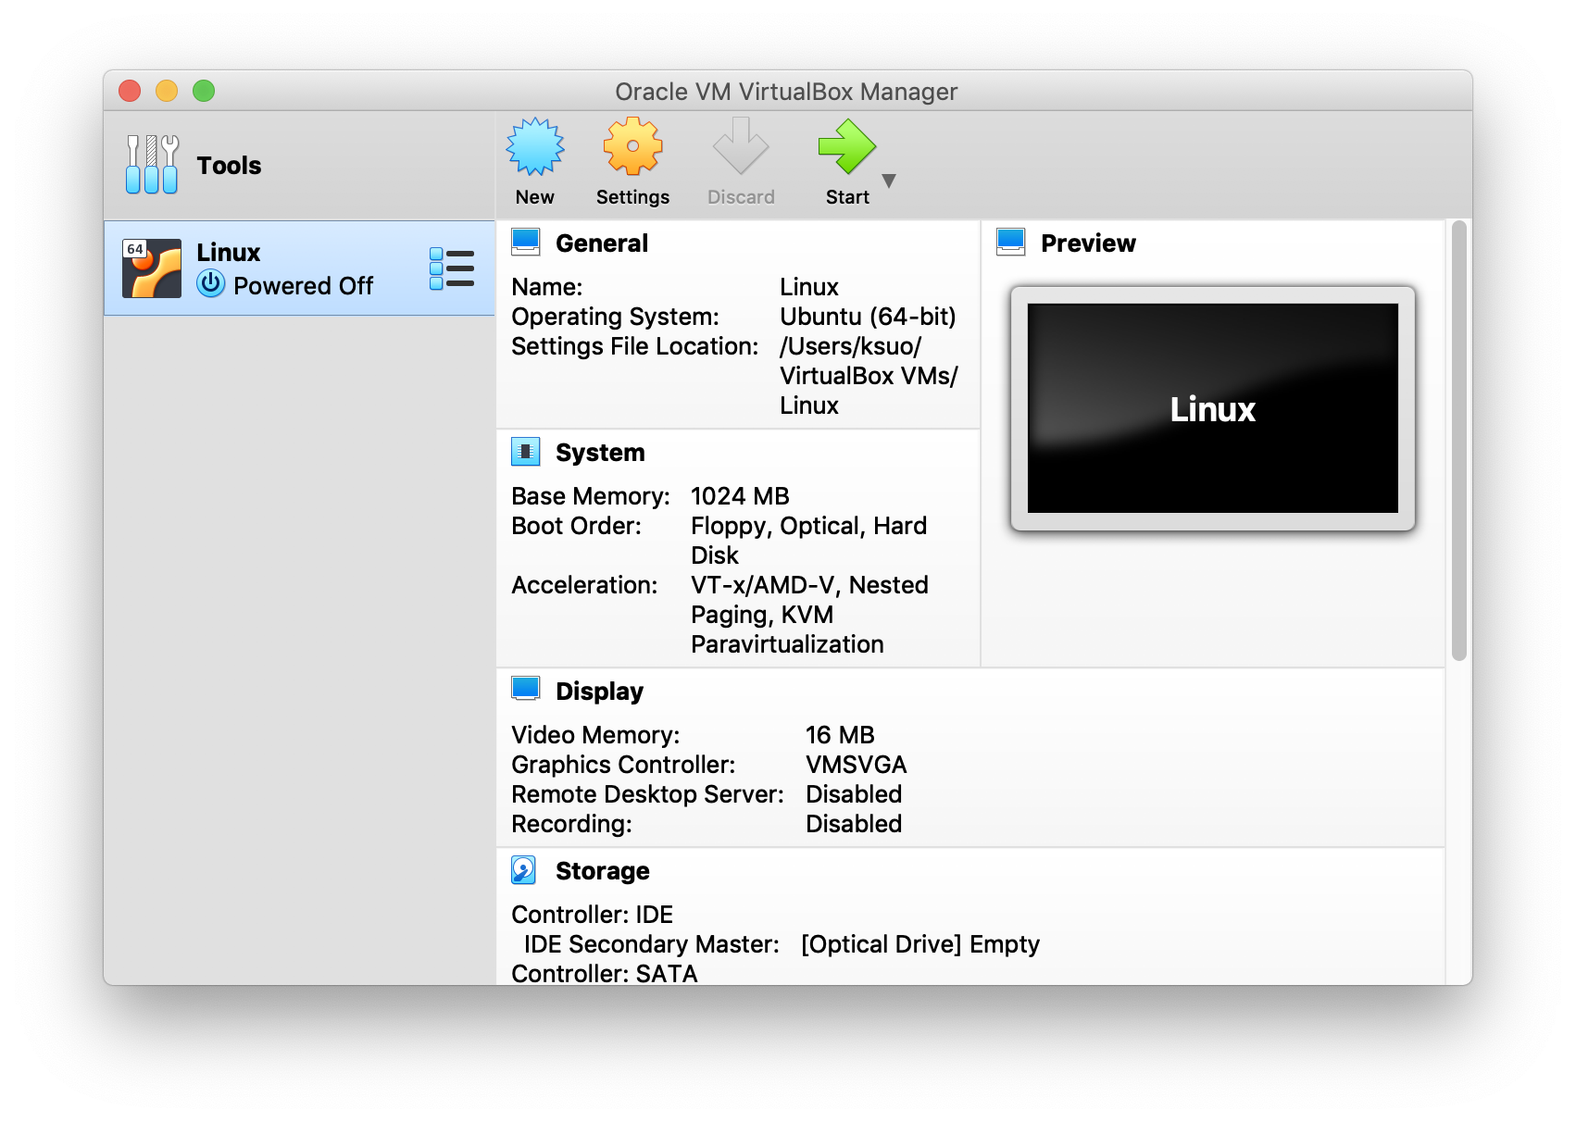
Project Environment
Recommend project environment (local)
VirtualBox + Ubuntu + Linux
Virtual machine
VM OS
VM OS Kernel
https://www.virtualbox.org/
https://ubuntu.com/download/desktop

Slide 12
Project Environment
Recommend project environment (local)
VirtualBox + Ubuntu + Linux
New to VirtualBox?
https://oracle-base.com/articles/vm/virtualbox-creating-a-new-vm
https://www.youtube.com/watch?v=sB_5fqiysi4
https://youtu.be/GDoCrfPma2k (MacOS)
You can access to VMs in KSU data centers (cloud) through https://cseview.kennesaw.edu/,
username: administration; password: linuxadmin

Slide 13
Why study parallel and distributed computation?
Most computer systems today are a certain form of parallel/distributed systems
Internet, datacenters, super computers, mobile devices
Most of the applications are parallel or even distributed apps (example: debug decompress file app, link, starts at 2:33)
To learn useful techniques to build large systems
A system with 10,000 nodes is different from one with 100 nodes
How to deal with imperfections
Machines can fail; network is slow; topology is not flat

Slide 14
What to learn
Parallel:
Library (Pthread, OpenMP, MPI)
Distribute:
Architectures
Processes
Communication
Synchronization
Consistency and replication
Fault tolerance and reliability
Distributed file systems, distributed scheduling systems, …

Slide 15
Expected Outcomes
Familiar with popular parallel programming libraries (Pthread, OpenMP, MPI)
Familiar with fundamentals of distributed systems
The ability to
Evaluate the performance of parallel and distributed systems
Write simple parallel and distributed programs
Understand the tradeoffs in distributed system design

Slide 16
Course Structure
Lectures
Time/Location
D2L/Course website
Projects
4 programming assignments
1 paper/project presentation
Exams (open books)
Midterm: in class/online D2L, TBA.
Final: in class/online D2L, TBA

Slide 17
Course Policy
Grading scale
Percentage | Grade
90 - 100 | A
80 - 89 | B
70 - 79 | C
60 - 69 | D
Below 60 | F

Slide 18
Grading Policy (cont.)
Grading percentage
Projects (x4): 40%
Presentation: 10%, including project or paper presentation
Midterm: 20%
Final exam: 30%
Late submission policy: late submission will not be accepted and no credits

Slide 19
Academic Integrity
Academic dishonesty
Cheating
Plagiarism
Collusion
The submission for credit of any work or materials that are attributable in whole or in part to another person
Taking an examination for another person
Any act designed to give unfair advantage to a student or the attempt to commit
https://scai.kennesaw.edu/KSU_Codes_of_Conduct_2019-2020.pdf
Receiving, attempting to receive, knowingly giving or attempting to give unauthorized assistance…
Do not upload course documents to 3rd party website without author’s permission

Slide 20
Where to go for help ?
Ask questions in class
Ask questions outside class
Classmates and friends
Attend office hours
Send Dr. Kun Suo emails or leave message on teams
Search on the web
Stand on the shoulder of giants

Slide 21
An example of parallel and distributed computation: Matrix multiplication

Slide 22
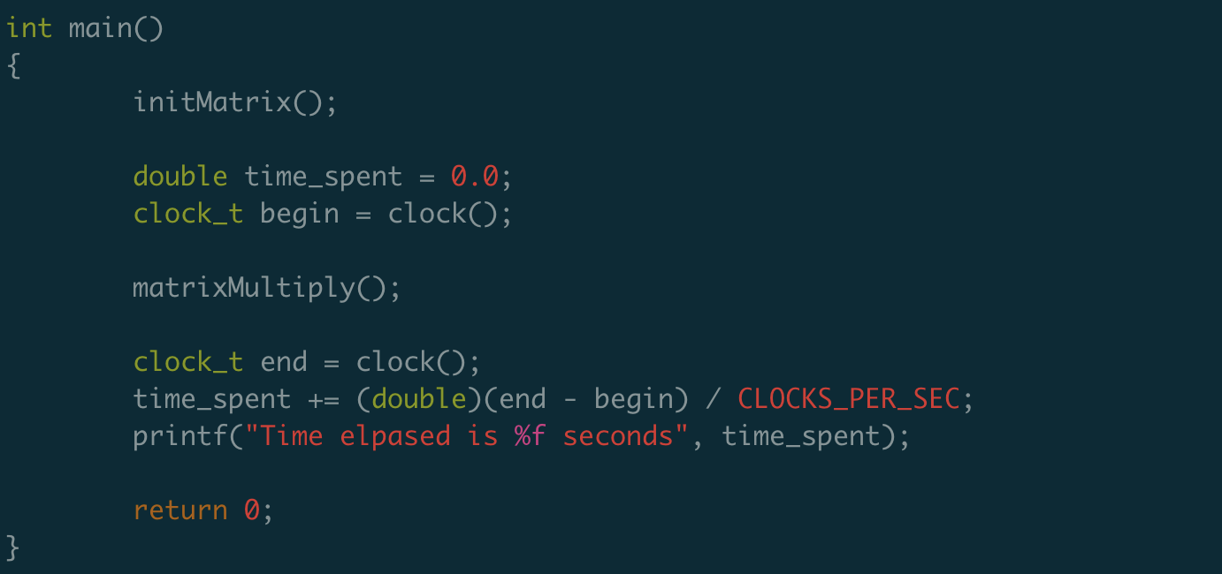
Matrix multiply
https://github.com/kevinsuo/CS7172/blob/master/matrix.c

Slide 23
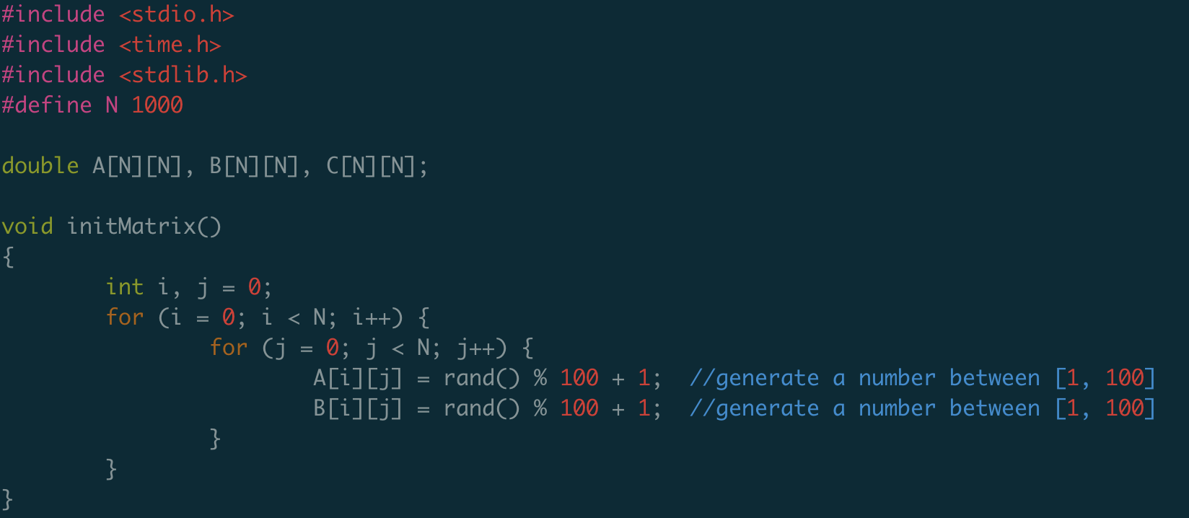
Matrix multiply
https://github.com/kevinsuo/CS7172/blob/master/matrix.c

Slide 24
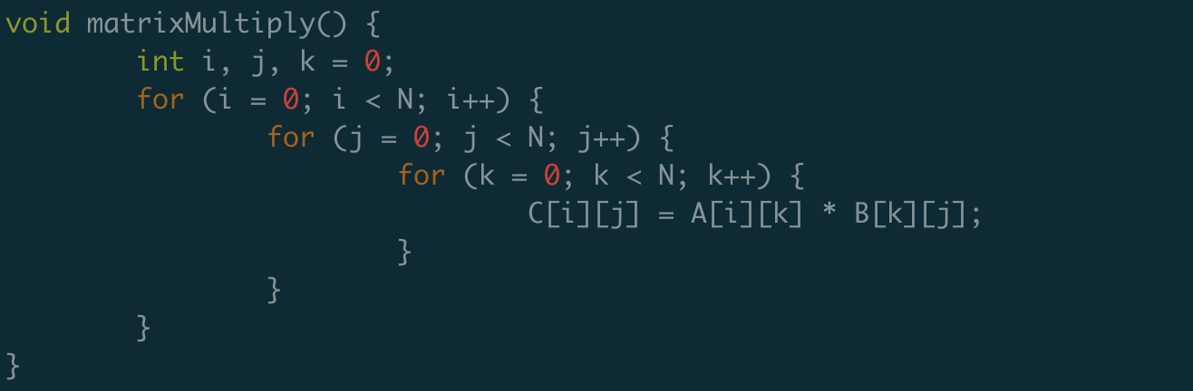
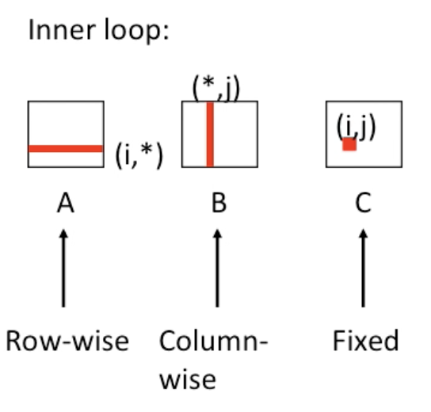
Matrix multiply
https://github.com/kevinsuo/CS7172/blob/master/matrix.c
+

Slide 25
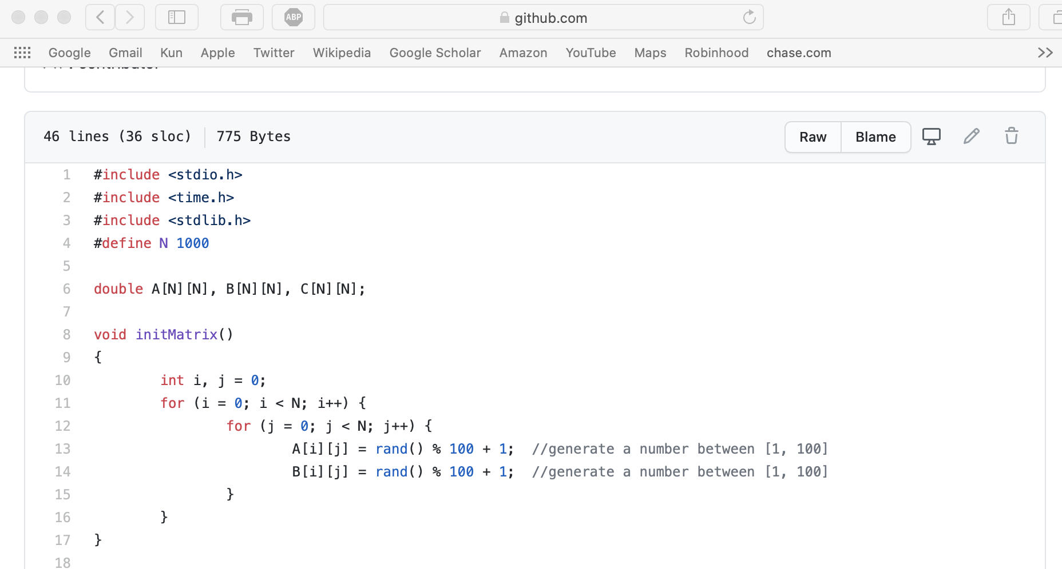
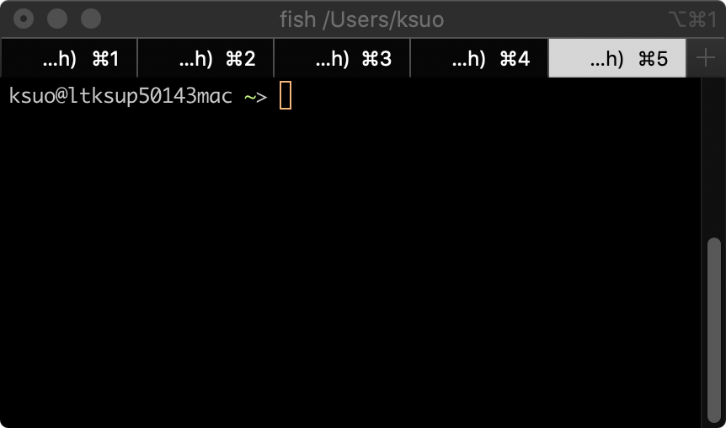
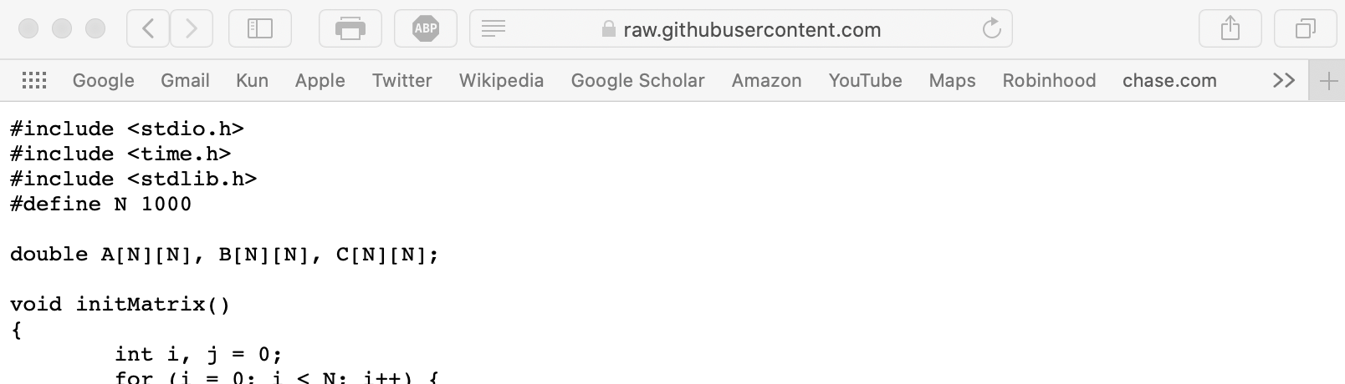
Matrix multiply
https://github.com/kevinsuo/CS7172/blob/master/matrix.c
1.
3.
$ wget URL
$ gcc filename.c –o filename.o
$ ./filename.o
(if no wget/gcc,
$ sudo apt install wget, gcc)
2. Copy the URL

Slide 26
Matrix multiply
How to run it faster?
Accelerate serial execution
Accelerate in parallel

Slide 27
How to run it faster?
Accelerate serial execution
Reduce unnecessary steps
2. Accelerate in parallel

Slide 28
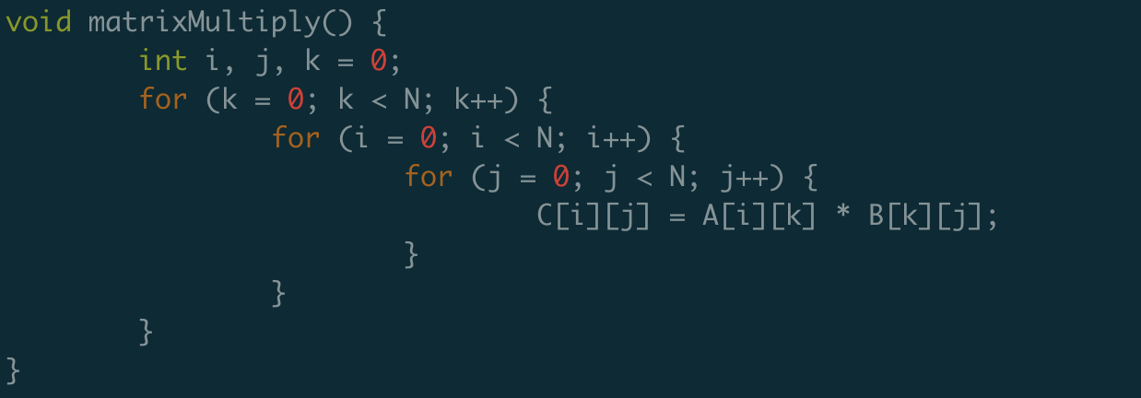
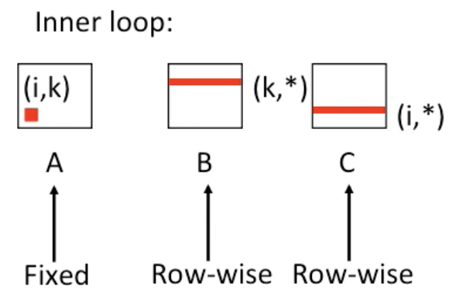
Option 1: Optimization using locality
+
https://github.com/kevinsuo/CS7172/blob/master/matrix-opt.c

Slide 29
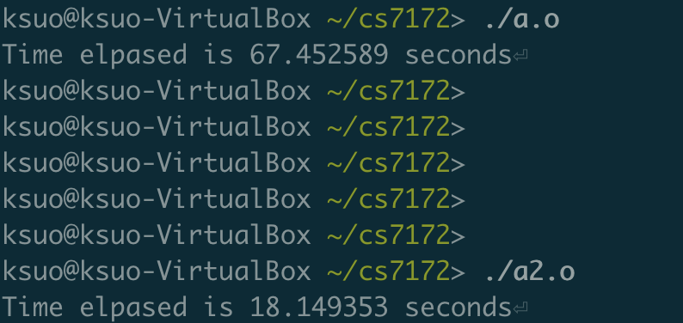
Option 1: Optimization using locality
N=2000
3.7x

Slide 30
Option 1: Optimization using locality
Temporal locality
Every inner loop reuse the value of A[i, k]
Spatial locality
Divide the large matrix into smaller ones and put it inside the cache during calculation

Slide 31
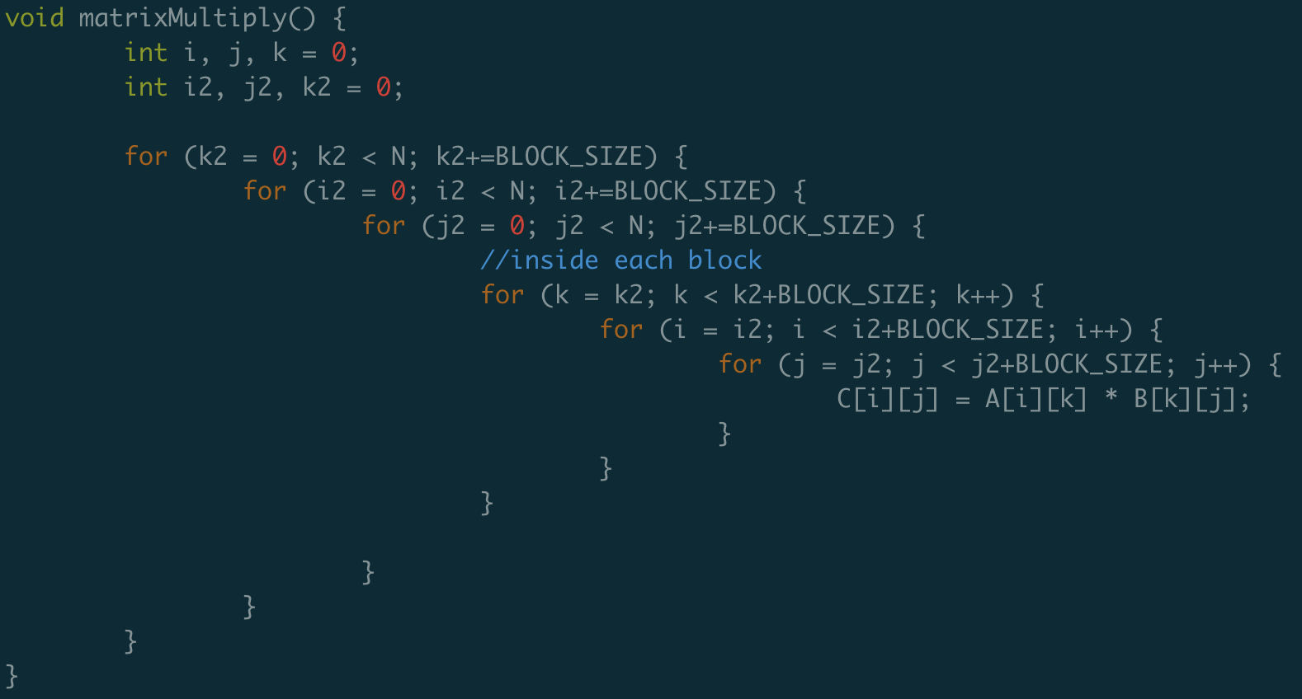
Option 1: Optimization using locality
https://github.com/kevinsuo/CS7172/blob/master/matrix-opt2.c
N = 2000
+

Slide 32
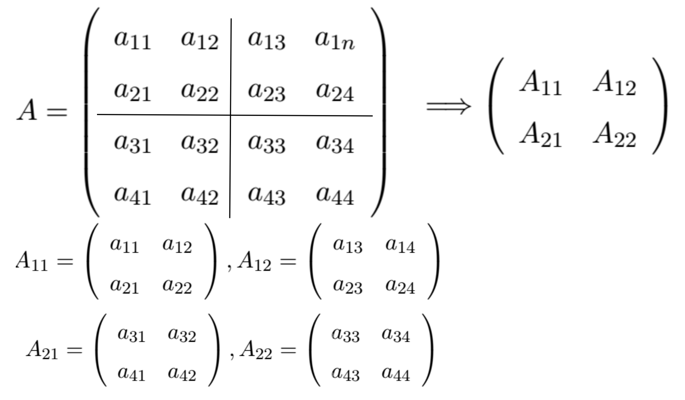
Option 1: Optimization using locality

Slide 33
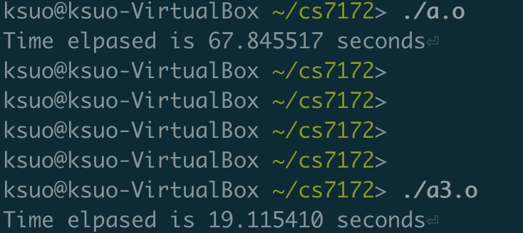
Option 1: Optimization using locality

Slide 34
Optimal 2: Optimization using parallel

Slide 35
Optimal 2: Optimization using parallel
Thread 1:
Thread 2:

Slide 36
Optimization and Speedup
 | N=200 | N=400 | N=800 | N=1600
matrix
matrix-opt1
matrix-opt2
 | N=200 | N=400 | N=800 | N=1600
matrix
matrix-opt1
matrix-opt2

Slide 37
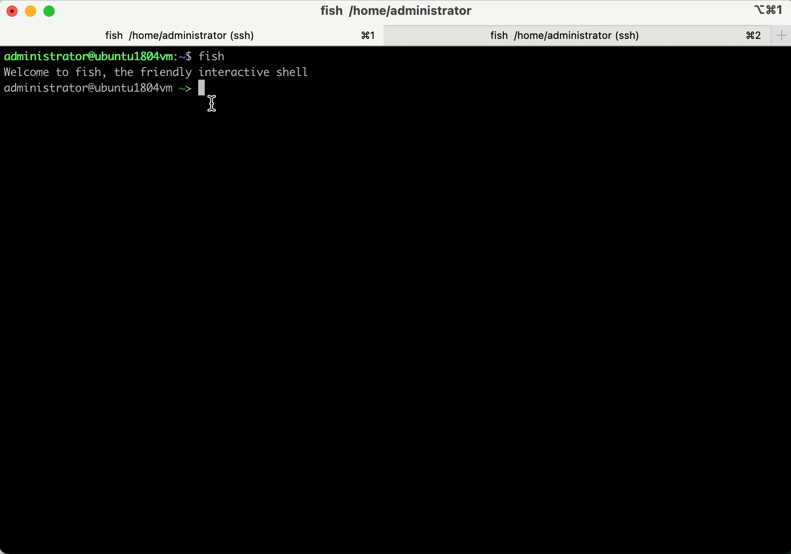
Single thread app demo
Single thread program

Slide 38
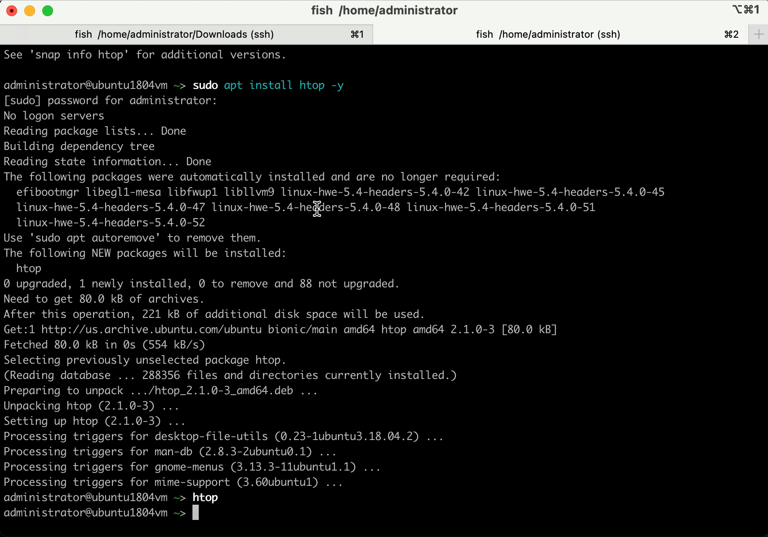
Multi-thread app demo
Multi-thread program

Slide 39
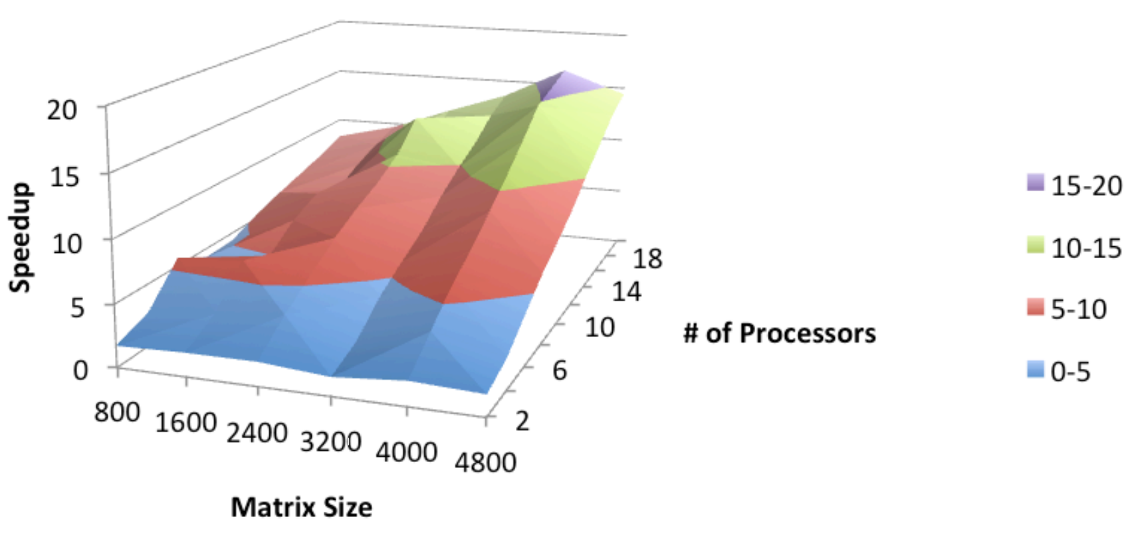
Optimal 2: Optimization using parallel
https://www.cse.unr.edu/~fredh/class/415/Nolan/matrix_multiplication/writeup.pdf

Slide 40
Example of distributed system: sorting
Sorting on a single machine, e.g., Database
select field_a from table_b order by field_a limit 100, 10;
db.collection_b
.find()
.sort({"field_a":1})
.skip(100)
.limit(10);
 | field_a | field_b | field_c
100
…
…
110
From line 100 to the next 10 lines of data

Slide 41

Example of distributed system: sorting
Workflow on a single node
One server

Slide 42
Example of distributed system: sorting
If the data is too much and single node cannot hold

Slide 43

Example of distributed system: sorting
Choose a node for merge processing
proxy

Slide 44
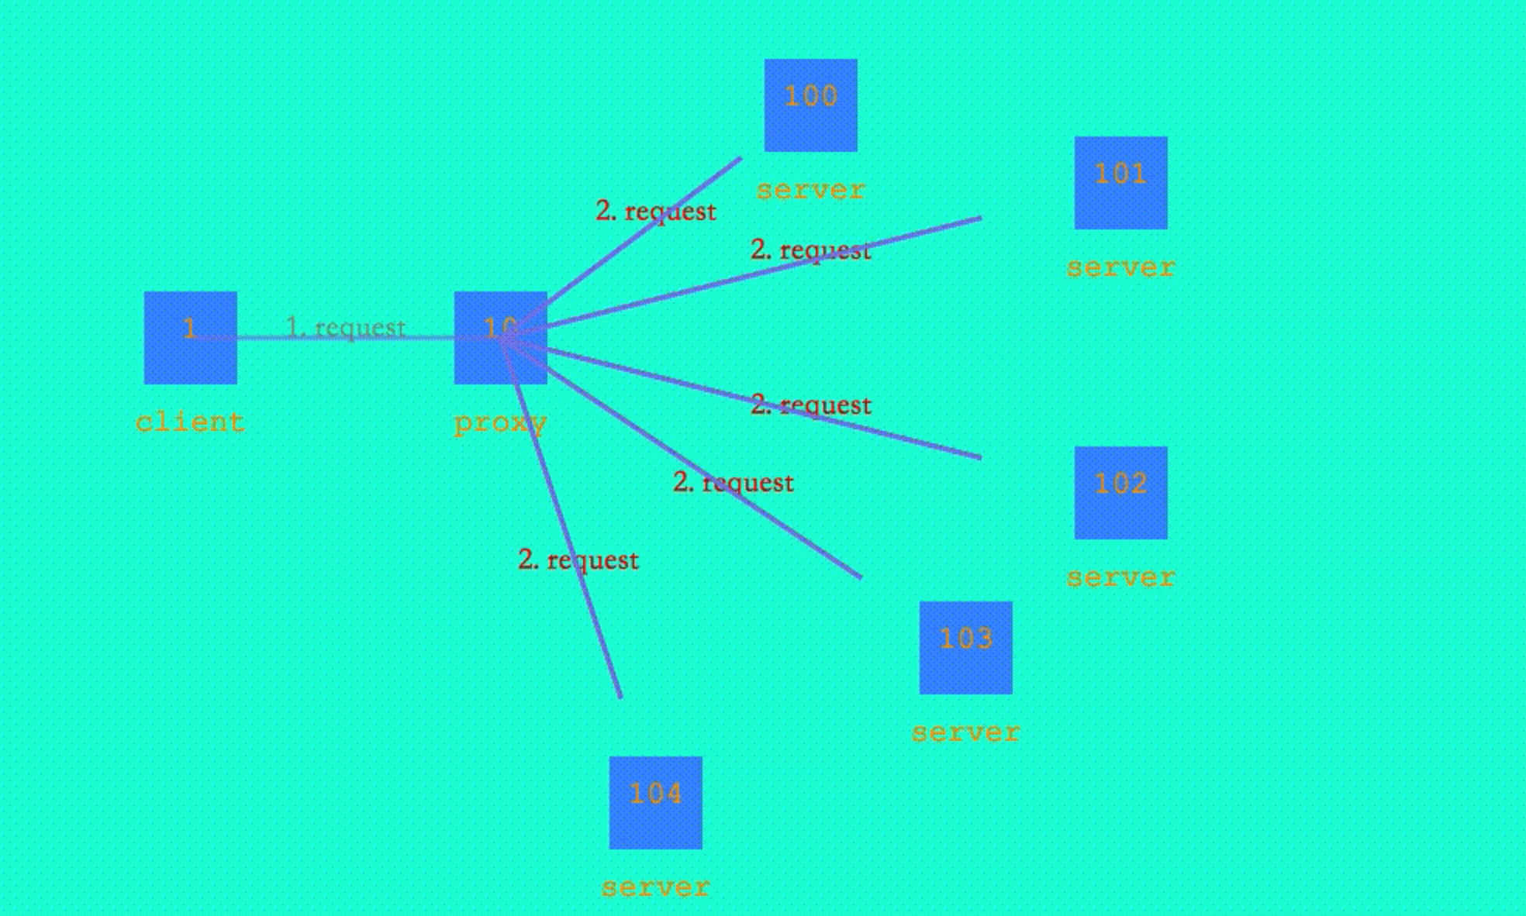
Example of distributed system: sorting
Workflow

Slide 45
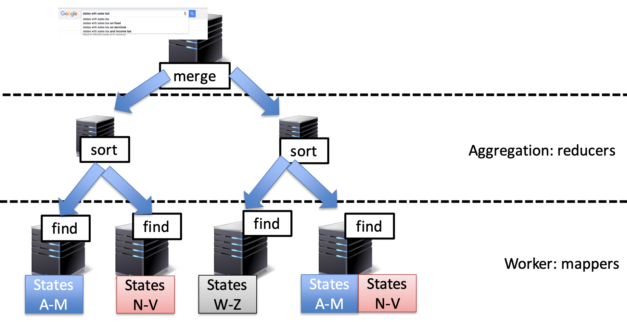
Example of distributed system: sorting
How Do Request Get Processed in a Data Center
Notes:
MapReduce is a programming framework that allows us to perform distributed and parallel processing on large data sets in a distributed environment. MapReduce consists of two distinct tasks – Map and Reduce
map job, where a block of data is read and processed to produce key-value pairs as intermediate outputs. The output of a Mapper or map job (key-value pairs) is input to the Reducer.
The reducer receives the key-value pair from multiple map jobs. Then, the reducer aggregates those intermediate data tuples (intermediate key-value pair) into a smaller set of tuples or key-value pairs which is the final output.

Slide 46

Example of distributed system: sorting
How Google Search Works
https://www.youtube.com/watch?v=0eKVizvYSUQ

Slide 47
Conclusion
Why study parallel and distributed computation?
What to learn?
Course structure
Course policy
An example of parallel and distributed computation

